Slide 1


Testing Django with Travis CI
Notes:
- Thank everyone for coming
-

Slide 2
slides
bit.ly/UhvbjV

Slide 3

About Me
Python Developer at
Twitter: @adammckerlie
Everywhere else: silent1mezzo
Notes:
- Gloat

Slide 4
Overview
Definitions
Why you should test your code
What parts of your code you should test
Writing your first test
Integrating Travis CI to automatically run your tests

Slide 5
Unit Test
Tests one small section of code
Focuses your code
Fast
Notes:
- Smallest section of testable code.
- Forces you to break out your code into small testable snippets
- Most likely doesn’t hit outside services, fast because it tests such a small portion of code

Slide 6
integration test
Tests that the whole system works (views, forms, etc...)
Slow
Gives you a full picture of what’s happening
Notes:
- Tests the entire application stack
- Sometimes slow because it tests the entire stack. In Django this can mean testing an entire view

Slide 7
why you should Write tests
Gives you confidence in your code
Allows you to iterate faster
Provides beginners an easy spot to code-dive
Untested code is expensive
Notes:
- Allows you to be more confident with continuous integration where you’re constantly releasing new features and testing as you go.
- Ability to iterate faster because you don’t have to manually check for regression errors
- Great spot beginners to the codebase to have a look around to see what the program does

Slide 8
“Code not tested is broken by design”
Jacob Kaplan-Moss
Notes:
- Your code should have tests
- If it doesn’t, go write some (even if it’s testing to make sure the view returns 200)

Slide 9
What you should test
Don’t test Django or Python’s built-in stuff
Test your views, models, forms, management commands, etc...
Notes:
- Don’t test things like the Python’s datetime module or Django’s model fields

Slide 10
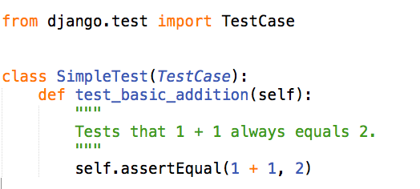
Writing your first test
Tests can go in models.py or tests.py
Must subclass django.test.TestCase
python manage.py test <app_name>
Notes:
- Tests should go in tests.py, you can have a tests directory with multiple files underneath it as long as you import into the tests module.
- There are test discovery tools like nose where you don’t have to do this

Slide 11
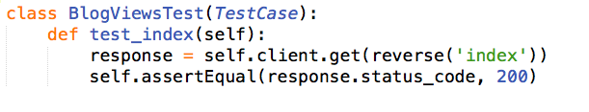
Every view should have this test
Notes:
- You should have at least one test for every view. This allows you to be confident there’s no syntax errors or url pattern errors

Slide 12
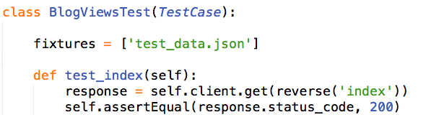
using fixtures
Fixtures are serialized data that you can load.
python manage.py dumpdata app_name > app_name/fixtures/file.json
Notes:
- Fixtures allow you to load data in when you want to test.
- dumpdata dumps your app’s data which is currently stored in the db to a file you specify.

Slide 13
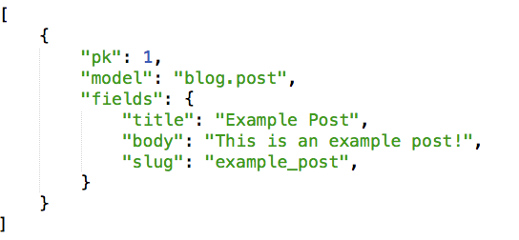
Notes:
- Here’s what a fixture can look like
- Json of the model
- Fixture names are "project-wide", so make sure your fixtures have a unique name, otherwise you may get unexpected data.

Slide 14
When should you test
After every commit
Before you merge your branches into master
Once you’ve deployed your code
Notes:
- You should test your code often
- Your code flow will vary but I always make sure to test before merging into master
- You should test your site after you’ve deployed to make sure there aren’t any weird performance issues
- Becomes unwieldy if you’re manually running your tests. This is where continuous integration comes in

Slide 15
What is Travis-ci?
Continuous Integration Testing
Open Source
https://github.com/travis-ci
Notes:
- CI is just the continuous process of applying tests to your code. Jenkins (Hudson) is another popular CI tool.
- Anyone can play around with the source code, help improve it

Slide 16


+
=
Notes:
I promise this is the only meme I’ll use.

Slide 17
how does it work?
Sign up with your github account
Specify repositories
Include a .travis.yml file
Change/commit/push code
Tests run automagically
Notes:
- Travis CI only tests Github Repositories
- Tests are currently only done on public repositories. Private repo’s are in beta testing.
- Used to have to set up the service hooks in github. Now travis gives you a list of all of your repositories and you specify which ones you’d like to test.
- I’ll go into the .travis.yml file later
- Develop your software like you normally would
- Tests run whenever you push your code

Slide 18
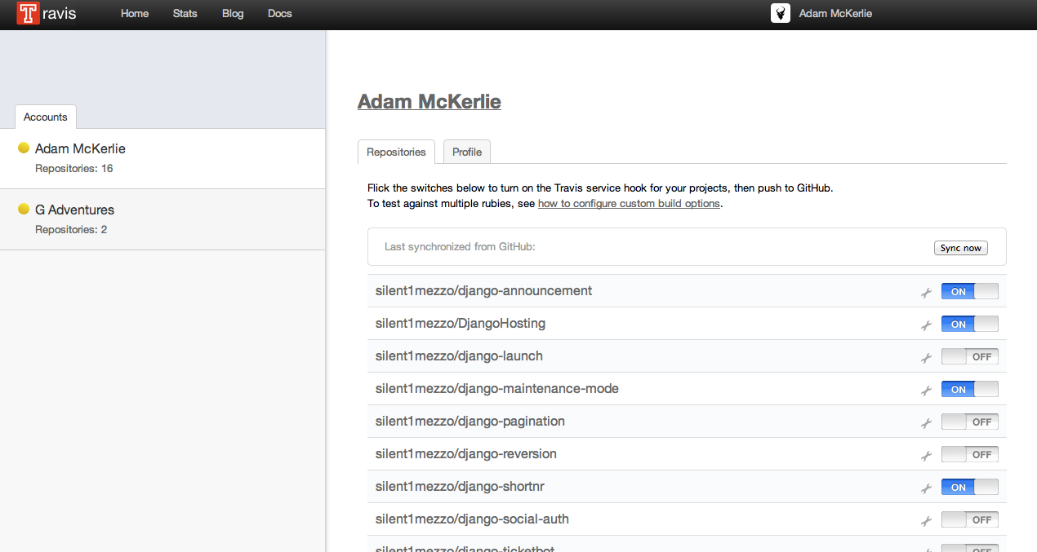
Notes:
- Profile screen
- You can sync all of your repositories here.

Slide 19
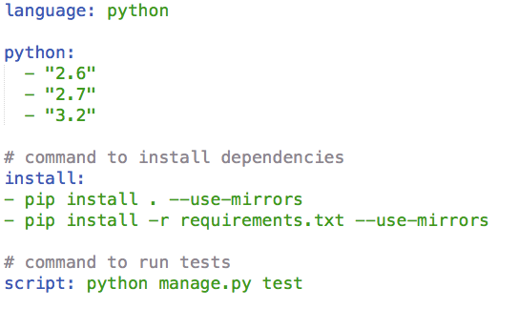
.travis.yml
Notes:
- First you define the language you want. Some examples are: Ruby, PHP, Go, Javascript
- Then choose your python versions
- Install your requirements
- First line will install your project using your setup.py file
- Second line obviously installs your requirements
- Finally run your tests.
- Can be manage.py test, nosetests, make tests or really any command

Slide 20
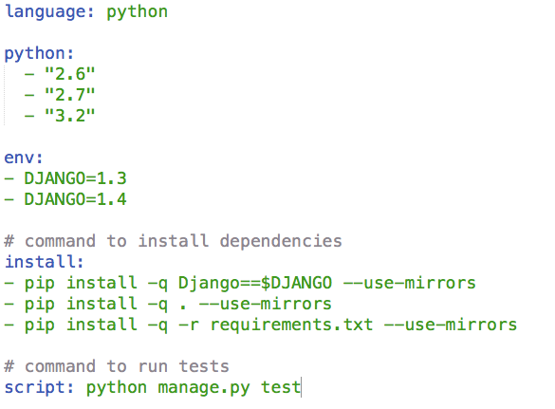
Environment Variables
Notes:
- If you want to test specific versions of software you can add the env key
- This will create a matrix where each version of python with each specific version of Django (or any other software) will be tested.

Slide 21
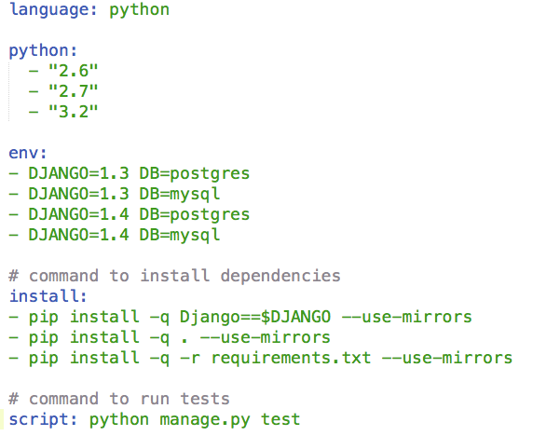
Using Databases
Notes:
- Works for databases as well
- PostgreSQL, MySQL, sqlite3, MongoDB

Slide 22

Pull Requests
Test Pull Requests before they’re merged to master
Notifications of running tests
Notifications of successful tests
Notes:
- Another great feature is the ability to test pull requests before they’re merged into master
- Travis takes your Pull Request, merges it into your branch and then tests code against the newly merged branch
- Notifications on the pull request page show the status of the tests

Slide 23
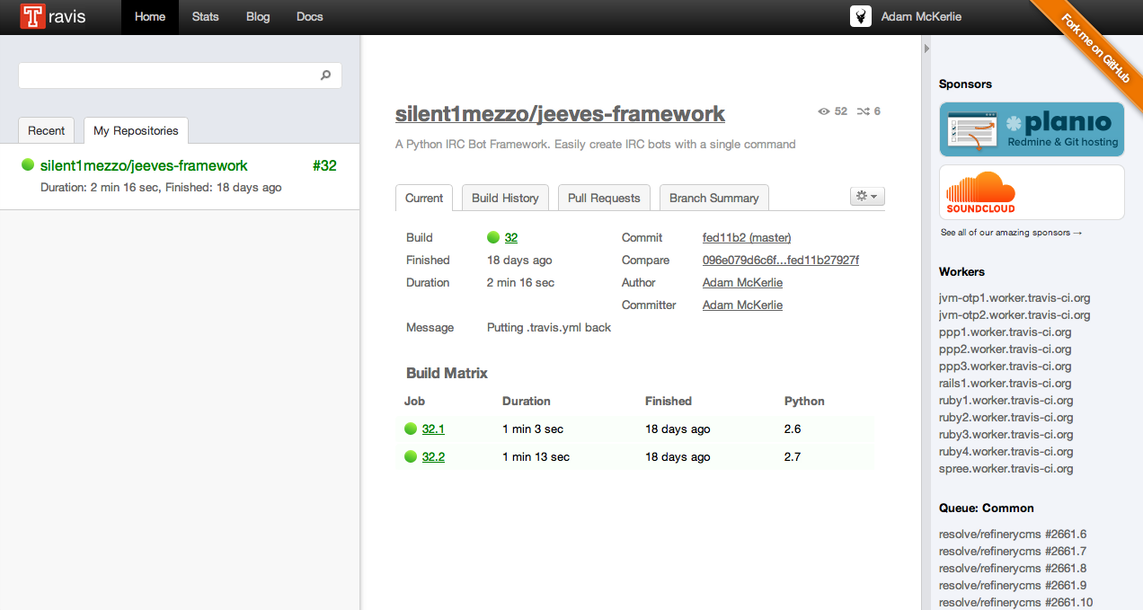
Notes:
- Application screen.
- Here you can see all of your builds (Build History)
- Pull Requests and branch summary.
- Gives you a lot of information about how your tests are going

Slide 24
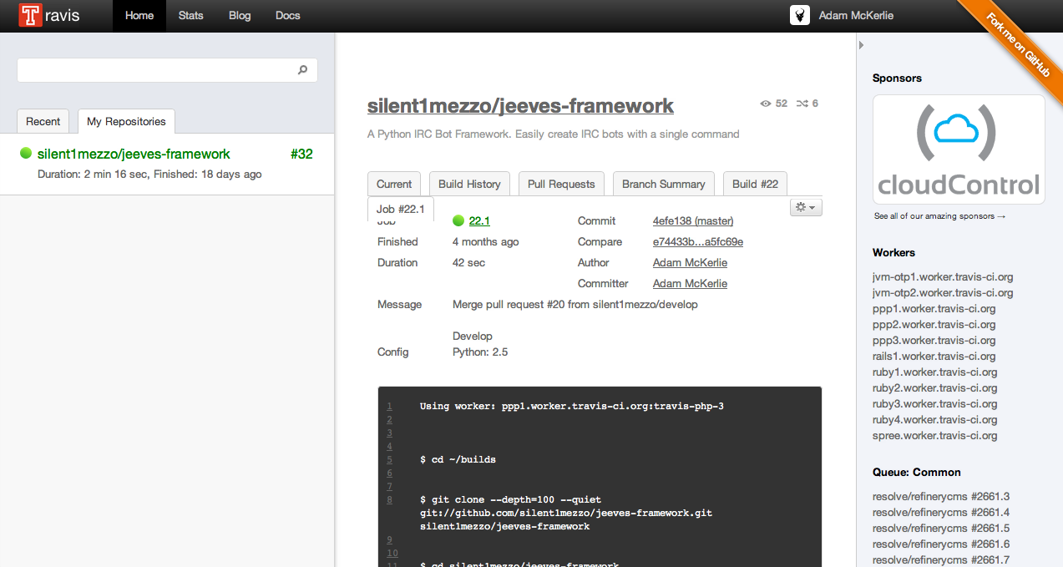
Notes:
- Here’s an individual build.
- Gives you the status, the duration, who wrote the code and committed it.
- Gives you a dump of the commands and output of your tests

Slide 25
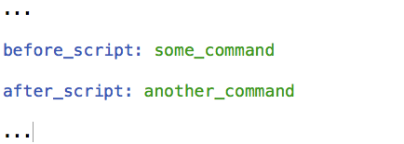
before/after_script
Notes:
- These keys are used to specify any commands that you want to run before/after travis-ci runs your tests
- Can be anything from setting up databases, running reports on tests, git hooks, etc...

Slide 26
Notifications
Notes:
- Travis CI can notify you in a number of different ways when your tests pass or fail.

Slide 27
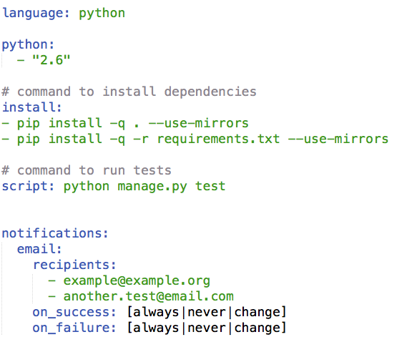
Email Notifications

Slide 28
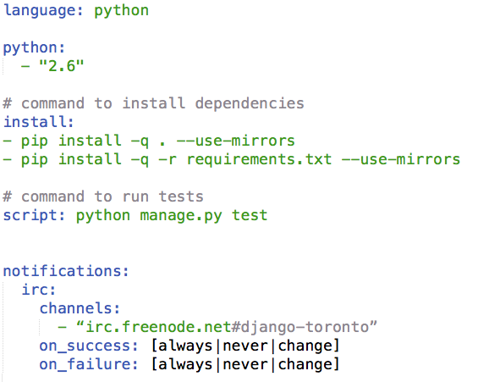
IRC Notifications

Slide 29
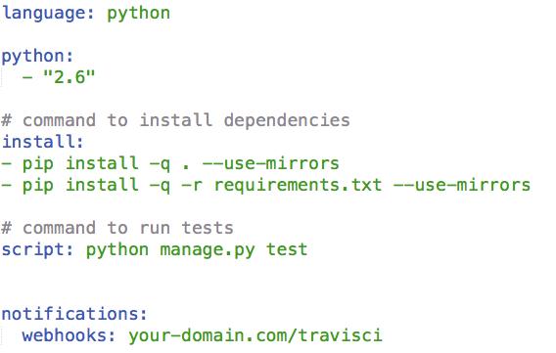
Webhook Notifications

Slide 30

final tips
[ci skip]
https://secure.travis-ci.org/[YOUR_GITHUB_USERNAME]/[YOUR_PROJECT_NAME].png
travis-lint
Notes:
- adding ci skip to a commit will tell Travis-CI to skip the tests for that commit
- This link shows whether your test are passing or not
- Travis Lint allows you to validate your .travis.yml file before

Slide 31
Questions?

